Slide 1
WIRELESS NEURAL RECORDER
Helping 70 Million Epilepsy Patients in THE WORLD

Slide 2
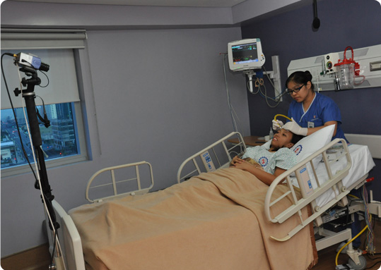

Slide 3
1% | 10 - 25 Million
5 - 6 Days

Slide 4
CUSTOMERS – EEG service providers
Hospitals | Clinics | Research Institutes
4000 | 5000 | 150

Slide 5
Total Market Value
Customers * Machines * Unit Price
~ $ 300 Million

Slide 6
Customer need
Safety & HIPAA
Convenience & Mobility
Accuracy & Reliability
Application development platform

Slide 7
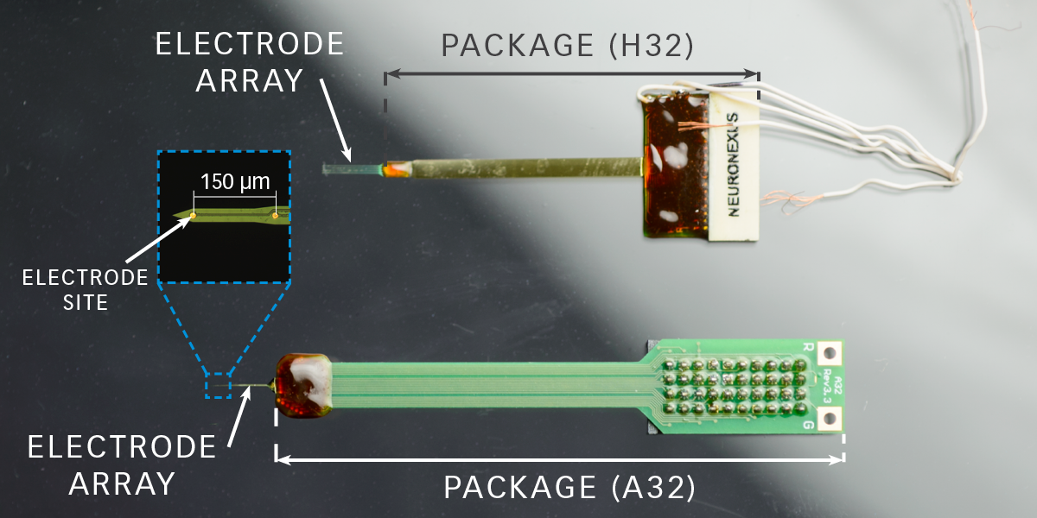
Existing product (NEuronexus)

Slide 8
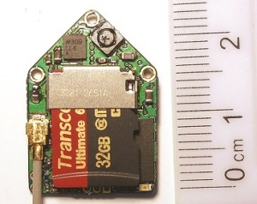
DEUTERON’s Smallest wireless neural logger
For animal applications
Size is still not ideal
Not Real-Time

Slide 9
Design Specifications
Safe
Skin Temperature Change: < 2C
DC Offset: no feedback current

Slide 10
Design Specifications
Real-Time Data Collection
Transmission Rate: 128 kB/s
Sampling Rate: 1 kHz

Slide 11
Design Specifications
Accurate and Comprehensive Data
Sampling Precision: 16-channel, 8-bit
Sampling Rate: 1 kHz

Slide 12
Design Specifications
Low Power and Long-Lasting
Battery Life: >= 24 Hours
User Replaceable/Rechargeable

Slide 13
Design Specifications
Portable/Convenient/User Friendly
Module Size: 4 x 4 mm
3 meter Operational Radius

Slide 14

System Diagram

Slide 15


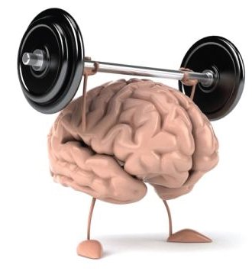
Challenges
Data Transmission
Power
Safety

Slide 16
Wireless Options
5 Potential Options for Wireless Data Transfer
Bluetooth Low Energy
Wifi 2.4 / 5 GHz
Other RF Bands
Zigbee
NFC

Slide 17
Wireless Options
5 Potential Options for Wireless Data Transfer
Bluetooth Low Energy
Wifi 2.4 / 5 GHz
Other RF Bands
Zigbee
NFC

Slide 18
Bluetooth Low Energy
Most likely use BLE as our transmission source with a TI CC2640 BLE 4.2
Industry-leading privacy. Keeps Bluetooth Smart devices from being tracked.
Highly secure. Features industry-standard encryption ensuring confidential data stays that way.
More power efficient. Introduces refinements that make Bluetooth Smart even more power-stingy.

Slide 19
Power Options
Powering the electrode is a huge challenge due to size and longevity constraints
2 Options
High density replaceable medical device batteries
Inductive charging via brain’s electrical impulses

Slide 20
Power Options
Powering the electrode is a huge challenge due to size and longevity constraints
2 Options
High density replaceable medical device batteries
Inductive charging via brain’s electrical impulses

Slide 21
Prototype Plan
3 Stages of prototyping with testing and iterating
Stage 1
Single electrode circuit prototype testing BLE technology with generated signals from oscilloscope
Stage 2
Multiple electrodes prototype to test multi-system communications
Stage 3
Full 16 electrode system with mobile recording device and animal testing

Slide 22
Wireless Neural Recorder
Applications not only limited to epilepsy
Sleep diagnosis
Diagnosis diseases of the brain
Coma analysis
Brain stimulation
Improve Epilepsy patients’ quality of life
Untether them from the limitation of existing technology
Improve monitoring with more data for better procedural

Slide 23
